Slide 1

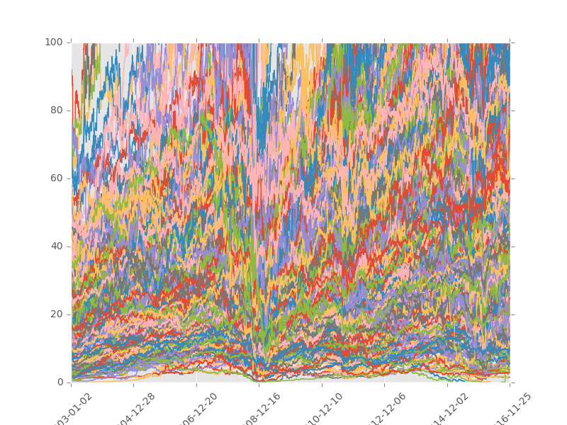
DAT-NYC-43: Capstone
John Hanlon

Slide 2
Executive Summary
Aim and Goals
Datasets
Methods, Models, and Analysis
Risks and Assumptions
Conclusion

Slide 3
Aim and Goals
The original goal of this exercise was to create a functioning mean reversion trading strategy
Similar to our session on time series
This became complex very quickly
After reviewing the datasets in scope, the reassessed goal of this exercise was to develop a machine learning classification algorithm to identify which securities might outperform the S&P 500
Classification features were financial performance metrics and ratios
Labels were assigned to a binary variable ‘status’
0: Underperform
1: Outperform

Slide 4
Executive Summary
Aim and Goals
Datasets
Methods, Models, and Analysis
Risks and Assumptions
Conclusion

Slide 5
Datasets
Several datasets were used to perform this analysis:
a.) Historical fundamental data and key metrics from S&P 500 listed companies between 2003-2013
b.) Historical SPY adjusted close price data (2003-2016)
c.) Historical price data for all S&P 500 listed companies (2003-2016)
These raw dataset were then joined into two data frames:
a.) Daily adjusted close prices for all of the securities in scope
b.) Merged dataset of all adjusted close prices and features for the securities in scope

Slide 6
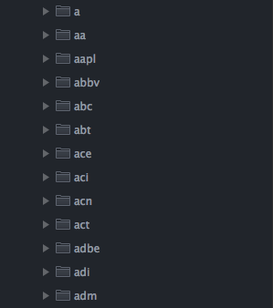
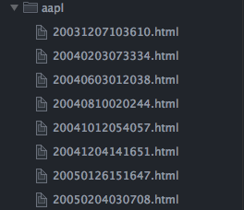
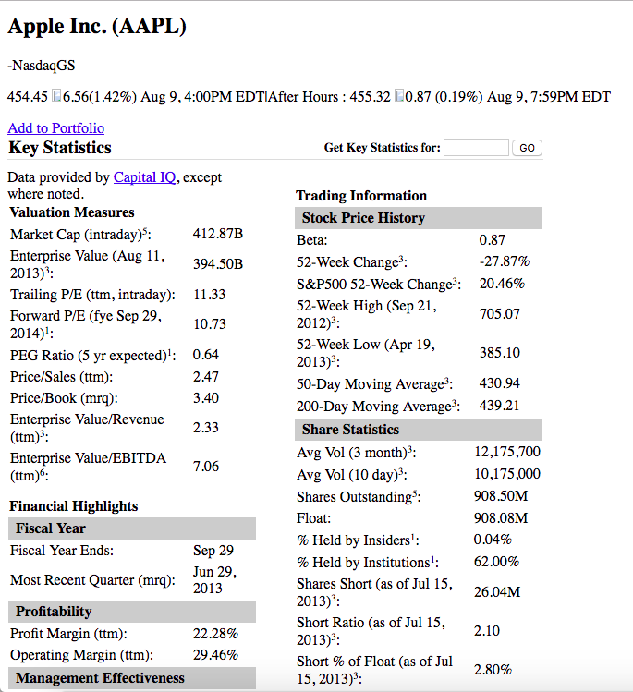
Datasets: Fundamental Data
Total Debt/Equity (mrq):</td><td class="yfnc_tabledata1">13.75</td></tr><tr><td class="yfnc_tablehead1" width="74%">Current Ratio (mrq):</td><td class="yfnc_tabledata1">1.88</td></tr><tr><td class="yfnc_tablehead1" width="74%">Book Value Per Share (mrq):</td><td class="yfnc_tabledata1">135.79</td></tr></table></td></tr></table><table class="yfnc_datamodoutline1" width="100%" cellpadding="0" cellspacing="0" border="0"><tr><td><table width="100%" cellpadding="2" cellspacing="1" border="0"><tr><td colspan="2" style="padding: 3px 8px;background-color:#CCC;"><b>Cash Flow Statement</b></td></tr><tr><td class="yfnc_tablehead1" width="74%">Operating Cash Flow (ttm):</td><td class="yfnc_tabledata1">52.89B</td></tr><tr><td class="yfnc_tablehead1" width="74%">Levered Free Cash Flow (ttm):</td><td class="yfnc_tabledata1">31.00B</td></tr></table></td></tr></table><table

Slide 7
Datasets: Historical Price & Adj. Close Stock Data
def stock_prices():
''' Searches the quandl api for the adjusted close price of each security in
our local dataset
Parameters
==========
Returns
=======
df : pandas dataframe
'''
df = pd.DataFrame()
statspath = '{}{}'.format(path, stocklist)
stock_list = [x[0] for x in os.walk(statspath)]
print('Fetching stock prices...')
for each_dir in stock_list[1:]:
try:
ticker = each_dir.split('/')[-1]
query = '{}{}'.format(q, ticker)
data = quandl.get(query, trim_start='2003-01-01',
trim_end='2016-11-30',
authtoken=api_key)
data[ticker] = data['Adj_Close']
df = pd.concat([df, data[ticker]], axis=1)
except Exception as e:
print(str(e), ticker)
df.to_csv('{}{}'.format(path, op))
print('Query completed...')

Slide 8
Datasets: Final Appended Data Frame

Slide 9
Executive Summary
Aim and Goals
Datasets
Methods, Models, and Analysis
Risks and Assumptions
Conclusion

Slide 10
Methods, Models, and Analysis
First, the historical stock price data needed to be pulled and appended into a single data frame for analysis

Slide 11
Methods, Models, and Analysis: Historical Adjusted Close Stock Data
def stock_prices():
df = pd.DataFrame()
statspath = '{}{}'.format(path, stocklist)
stock_list = [x[0] for x in os.walk(statspath)]
print('Fetching stock prices...')
for each_dir in stock_list[1:]:
try:
ticker = each_dir.split('/')[-1]
query = '{}{}'.format(q, ticker)
data = quandl.get(query, trim_start='2003-11-21',
trim_end='2016-11-30',
authtoken=api_key)
data[ticker] = data['Adj_Close']
df = pd.concat([df, data[ticker]], axis=1)
except Exception as e:
print(str(e), ticker)
df.to_csv('{}{}'.format(path, op))
print('Query completed...')

Slide 12
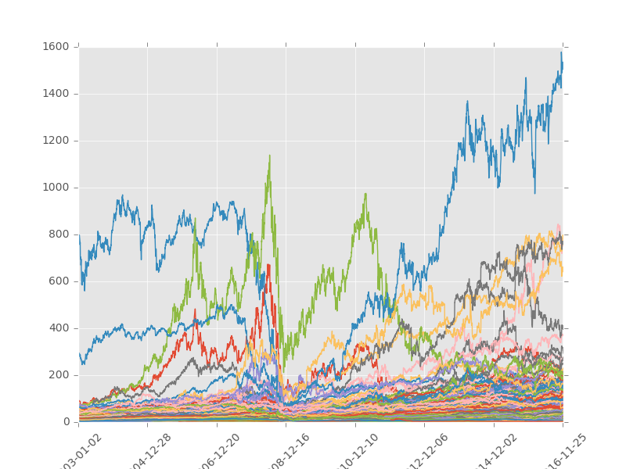
Methods, Models, and Analysis
Analyzing the chart helps to show if the query was successful
In this case, it does
No glaring data gaps
Most securities trade < $100/share
def plot_df():
df = pd.read_csv('{}{}'.format(path, op))
df.plot(x=df['Date'], legend=None)
plt.xticks(rotation=45)
plt.show()
plot_df()

Slide 13
Methods, Models, and Analysis
This dataset was queried from archived finance.yahoo.com data
Thus, historical fundamental data set was provided in html code
By using ‘gather’ and importing re (regular expressions), we were able to parse the fundamental metrics in each file
def Key_Stats(gather=['Total Debt/Equity',
'Trailing P/E',
'Price/Sales',
'Price/Book',
'Profit Margin',
'Operating Margin',
'Return on Assets',
'Return on Equity',
'Revenue Per Share',
'Market Cap',
'Enterprise Value',
'Forward P/E',
'PEG Ratio',
'Enterprise Value/Revenue',
'Enterprise Value/EBITDA',
'Revenue',
'Gross Profit',
'EBITDA',
…
'Shares Short (prior ']):
rx = '.*?(\d{1,8}\.\d{1,8}M?B?|N/A)%?'
regex = re.escape(each_data) + r'{}'.format(rx)
value = re.search(regex, source)
value = (value.group(1))

Slide 14
Methods, Models, and Analysis: Fundamental Data
Total Debt/Equity (mrq):</td><td class="yfnc_tabledata1">13.75</td></tr><tr><td class="yfnc_tablehead1" width="74%">Current Ratio (mrq):</td><td class="yfnc_tabledata1">1.88</td></tr><tr><td class="yfnc_tablehead1" width="74%">Book Value Per Share (mrq):</td><td class="yfnc_tabledata1">135.79</td></tr></table></td></tr></table><table class="yfnc_datamodoutline1" width="100%" cellpadding="0" cellspacing="0" border="0"><tr><td><table width="100%" cellpadding="2" cellspacing="1" border="0"><tr><td colspan="2" style="padding: 3px 8px;background-color:#CCC;"><b>Cash Flow Statement</b></td></tr><tr><td class="yfnc_tablehead1" width="74%">Operating Cash Flow (ttm):</td><td class="yfnc_tabledata1">52.89B</td></tr><tr><td class="yfnc_tablehead1" width="74%">Levered Free Cash Flow (ttm):</td><td class="yfnc_tabledata1">31.00B</td></tr></table></td></tr></table><table

Slide 15
Methods, Models, and Analysis
This dataset was queried from archived finance.yahoo.com
Thus, historical fundamental data set was provided in html code
By using ‘gather’ and importing re (regular expressions), we were able to parse the fundamental metrics in each file and return it to a single data frame
def Key_Stats(gather=['Total Debt/Equity',
'Trailing P/E',
'Price/Sales',
'Price/Book',
'Profit Margin',
'Operating Margin',
'Return on Assets',
'Return on Equity',
'Revenue Per Share',
'Market Cap',
'Enterprise Value',
'Forward P/E',
'PEG Ratio',
'Enterprise Value/Revenue',
'Enterprise Value/EBITDA',
'Revenue',
'Gross Profit',
'EBITDA',
…
'Shares Short (prior ']):
rx = '.*?(\d{1,8}\.\d{1,8}M?B?|N/A)%?’
regex = re.escape(each_data) + r'{}'.format(rx)
value = re.search(regex, source)
value = (value.group(1))

Slide 16
Methods, Models, and Analysis
Now that we have all our raw data, we’ll need to start to manipulate prior to analysis
In order to test the model and see if a company’s fundamentals are predictive, there has to be a metric to evaluate
1-year future price
try:
stock_price_1y = datetime.fromtimestamp(one_year_later).strftime('%Y-%m-%d')
row = stock_df[(stock_df['Date'] == stock_price_1y)][ticker]
stock_1y_value = round(float(row), 2)
except Exception as e:
try:
stock_price_1y = datetime.fromtimestamp(
one_year_later - 259200).strftime('%Y-%m-%d')
row = stock_df[(stock_df['Date'] == stock_price_1y)][ticker]
stock_1y_value = round(float(row), 2)
except Exception as e:
print('ERROR IN SECTION 3: ', ticker, str(e))
try:
stock_price = datetime.fromtimestamp(unix_time).strftime('%Y-%m-%d')
row = stock_df[(stock_df['Date'] == stock_price)][ticker]
stock_price = round(float(row), 2)
except Exception as e:
try:
stock_price = datetime.fromtimestamp(unix_time - 259200).strftime('%Y-%m-%d')
row = stock_df[(stock_df['Date'] == stock_price)][ticker]
stock_price = round(float(row), 2)
except Exception as e:
print('ERROR IN SECTION 4: ', ticker, str(e))

Slide 17
Methods, Models, and Analysis
A few variables must now be addressed…
p_change was defined as the price delta of the security or SPY 1 year in the future
So, if this security was purchased and sold after a year, how much would money would be made or lost?
Classify the dataset with this variable
The adjacent figure shows that in order to be classified as ‘outperform’ the security must have returned 5% more than the SPY
stock_p_change = round(((stock_1y_value - stock_price) /
stock_price * 100.0), 2)
sp500_p_change = round(((sp500_1y_value - sp500_value) /
sp500_value * 100.0), 2)
difference = stock_p_change - sp500_p_change
if difference > 5:
status = 'outperform’
else:
status = 'underperform'
if value_list.count('N/A') > 0:
pass

Slide 18
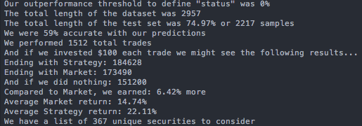
Methods, Models, and Analysis
Three Linear SVC scenarios were tested:
The first test set the outperformance threshold to 0%
From a universe of 446 securities, the model found 367 unique companies to invest in, and outperformed the market by 6%
def Build_Data_Set():
data_df = pd.read_csv('{}{}'.format(path, key_stats_csv))
data_df = data_df.reindex(
np.random.permutation(data_df.index))
data_df = data_df.replace('NaN', 0).replace('N/A', 0)
X = np.array(data_df[FEATURES].values)
y = (data_df['status'].replace('underperform', 0).replace('outperform', 1).values.tolist())
X = preprocessing.scale(X)
Z = np.array(data_df[['stock p change', 'sp500 p change', ‘Price', 'Ticker']])
X, y, Z = Build_Data_Set()
test_size = int(len(X) * 0.75)
clf = svm.SVC(kernel='linear’,C=1.0)
clf.fit(X[:test_size], y[:test_size])
correct_count = 0
ticker_list = []
for x in range(1, test_size + 1):
if clf.predict(X[-x])[0] == y[-x]:
correct_count += 1
if clf.predict(X[-x])[0] == 1:
invest_return = invest_amount + (invest_amount * (Z[-x][0] / 100))

Slide 19
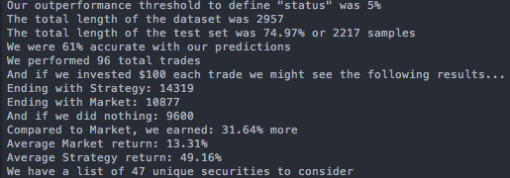
Methods, Models, and Analysis
Three Linear SVC scenarios were tested:
The second test set the outperformance threshold to 5%
From a universe of 446 securities, the model found 47 unique companies to invest in, and outperformed the market by 32%
def Build_Data_Set():
data_df = pd.read_csv('{}{}'.format(path, key_stats_csv))
data_df = data_df.reindex(
np.random.permutation(data_df.index))
data_df = data_df.replace('NaN', 0).replace('N/A', 0)
X = np.array(data_df[FEATURES].values)
y = (data_df['status'].replace('underperform', 0).replace('outperform', 1).values.tolist())
X = preprocessing.scale(X)
Z = np.array(data_df[['stock p change', 'sp500 p change', ‘Price', 'Ticker']])
X, y, Z = Build_Data_Set()
test_size = int(len(X) * 0.75)
clf = svm.SVC(kernel='linear’,C=1.0)
clf.fit(X[:test_size], y[:test_size])
correct_count = 0
ticker_list = []
for x in range(1, test_size + 1):
if clf.predict(X[-x])[0] == y[-x]:
correct_count += 1
if clf.predict(X[-x])[0] == 1:
invest_return = invest_amount + (invest_amount * (Z[-x][0] / 100))

Slide 20
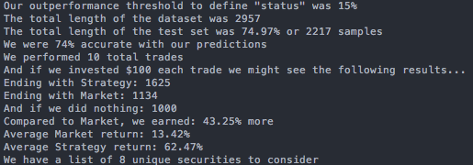
Methods, Models, and Analysis
Three Linear SVC scenarios were tested:
The final test set the outperformance threshold to 15%
From a universe of 446 securities, the model found 8 unique companies to invest in, and outperformed the market, by 62%
def Build_Data_Set():
data_df = pd.read_csv('{}{}'.format(path, key_stats_csv))
data_df = data_df.reindex(
np.random.permutation(data_df.index))
data_df = data_df.replace('NaN', 0).replace('N/A', 0)
X = np.array(data_df[FEATURES].values)
y = (data_df['status'].replace('underperform', 0).replace('outperform', 1).values.tolist())
X = preprocessing.scale(X)
Z = np.array(data_df[['stock p change', 'sp500 p change', ‘Price', 'Ticker']])
X, y, Z = Build_Data_Set()
test_size = int(len(X) * 0.75)
clf = svm.SVC(kernel='linear’,C=1.0)
clf.fit(X[:test_size], y[:test_size])
correct_count = 0
ticker_list = []
for x in range(1, test_size + 1):
if clf.predict(X[-x])[0] == y[-x]:
correct_count += 1
if clf.predict(X[-x])[0] == 1:
invest_return = invest_amount + (invest_amount * (Z[-x][0] / 100))

Slide 21
Executive Summary
Aim and Goals
Datasets
Methods, Models, and Analysis
Risks and Assumptions
Conclusion

Slide 22
Risks and Assumptions
How the fundamental dataset was populated
Only training on high performing securities?
Temporal
Fundamental dataset is from 2003-2013
Need input from 2014-2016
No indicator entry / exit indicators

Slide 23
Executive Summary
Aim and Goals
Datasets
Methods, Models, and Analysis
Risks and Assumptions
Conclusion

Slide 24
Conclusion
Model is a screener for identifying which securities to research further
Need to investigate, standardize, and aggregate more data
Address risk/assumption control points
Taking it a step further, will look into creating a model to systematically value these companies with new data

Slide 25
Acknowledgements
Stefan and Phillippa – thank you!
DAT-NYC-43 class
Stack Overflow, Google, Sentdex, and online community

